Slide 1
Chapter 5
Tree Structures

Slide 2
Introduction
A tree is a set of nodes and edges that connect pairs of nodes.
It is an abstract model of a hierarchical structure.
Unlike a real tree, tree data structures are typically depicted upside down, with the root at the top and the leaves at the bottom.
Each node can have a number of child nodes, and the parent
and child nodes are connected by arcs.
The root is the top node that has no parent nodes.
The leaves of the tree are those that have no child nodes.

Slide 3
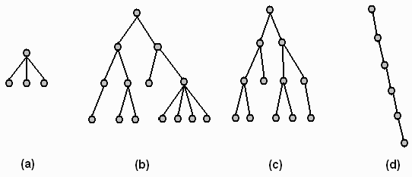
Example

Slide 4
Cont...
A path through the tree to a node is a sequence of arcs that connect the root to the node.
The length of a path is the number of arcs in the path.
The level of a node is equal to the length of the path from the root to the node plus 1.
The root node is said to be at level 1 of the tree, its children at level 2, and so on.
The height of a tree is equal to the maximum level of a node in the tree and is one more than the depth of the deepest node in the tree

Slide 5
Showing hierarchy
Trees can be useful data structures as they often express the structure of real world information more accurately.
This information would not be easy to represent in a linear data structure such as a linked list or an array.

Slide 6
Binary Tree
A binary tree is a tree whose nodes have at most two children each
Full binary tree: is a binary tree where each node has either zero or two children
Balanced Binary Tree: where each node except the leaf nodes has a left and right children and all the leafs are at the same degree.
also referred to as a height-balanced binary tree, is defined as a binary tree in which the height of the left and right subtree of any node differ by not more than 1

Slide 7
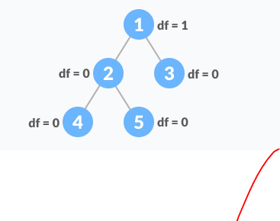
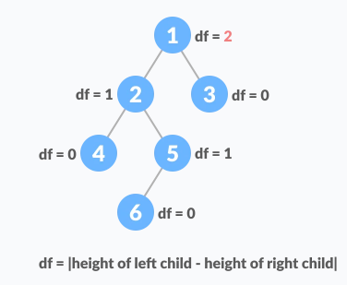
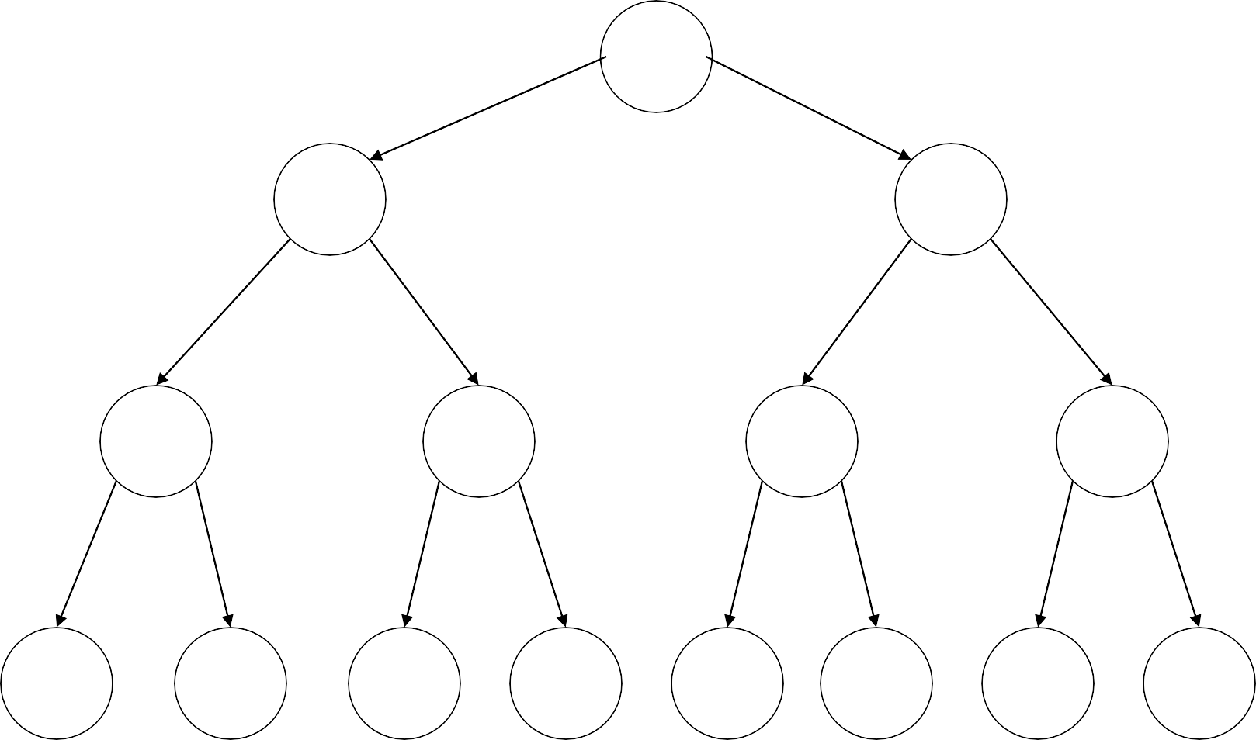
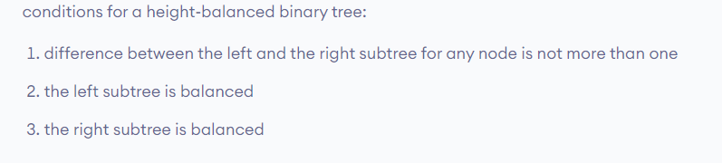
Balanced Binary Tree
A Full Binary Tree
unbalanced Binary Tree

Slide 8
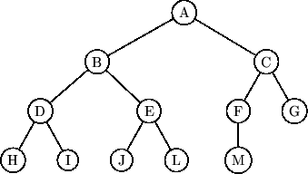
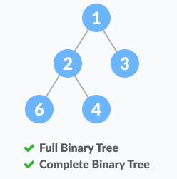
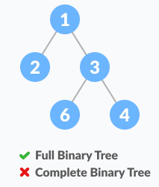
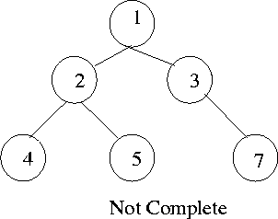
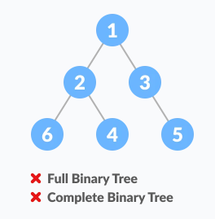
Cont…
Complete Binary Tree: is a binary tree in which the level of the any leaf node is either H or H-1 where H is the height of the tree.
The deepest level should also be filled from left to right.

Slide 9
Binary Search Tree (Ordered Binary Tree)
It is a binary tree which allows us to maintain a sorted list of numbers
It is a binary tree which can be empty or satisfies the following:
» Every node has a key and no two nodes have the same key.
» The keys in the right sub tree are larger than the keys in the root.
» The keys in the left sub tree are smaller than the keys in
the root.
» The left and right sub trees are also binary search trees.

Slide 10
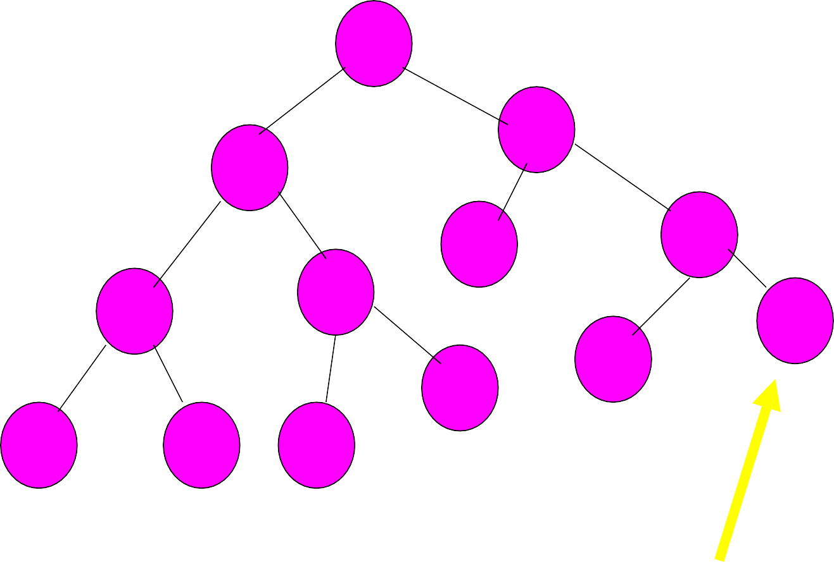
Cont..
15
20
10
17
23
13
6
24
22
14
4
8
12
Can’t have left child b/c there is no #23

Slide 11
Data structure of Binary Tree
Struct datamodel
{
datafield declaration;
datamodel *left, *right;
}
datamodel *rootpointer=NULL;

Slide 12
Operation on Binary search tree
Insertion
Searching
Deletion

Slide 13
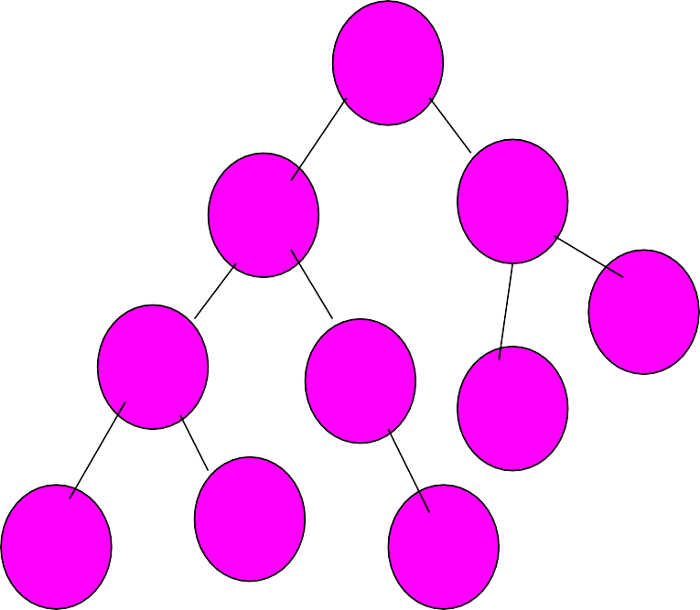
Operations on Binary Search Tree
Consider the following structure
Struct Node
{
10
int num;
Node *left,*right;
};
Node *rootnodeptr=NULL;
5
13
14
3
6
11
4
2
7

Slide 14
Cont…
//insert in to a binary search tree, RNP=rootnodeptr, NNP=newnodeptr
Node *RNP, Node *NNP
void insertBST(Node *RNP, Node *NNP){
int inserted=0;//a flag to check inserted or not Node *temp;
temp=RNP; if(temp==NULL)
{
temp=NNP; RNP=NNP;}
else{
while(inserted==0){
if(temp->num > NNP->num){ if(temp->left==NULL){
temp->left=NNP inserted=1;}
else
temp=temp->left;}
16

Slide 15
Cont…
else { //if temp->num <NNP->num if(temp->right==NULL){
temp->right=NNP; inserted=1;}
else
temp=temp->right
}//else
}//end of while
}//end of function

Slide 16
Node Searching
Searching a binary search tree is similar to the process performed when inserting an item:
Compare the item that you are looking for with the root, and Then push the comparison down into the left or right subtree.
This takes at most as many comparisons as the height of the tree.
At worst, this will be the number of nodes in the tree minus one.

Slide 17
Implementation
Function call:
» elementExists=searchBST(RNP,number);
The function
bool searchBST(Node *CurrNodeptr,int x)
{
if(currNodeptr==NULL)
return (false);
else if (currNodeptr->num==x)
return (true);
else if (currNodeptr->num>x)
return (searchBST(currNodeptr->left,x);
else
return (searchBST(currNodeptr->right,x);
}

Slide 18
Deletion
Deletion of a node from a binary search tree can be more problematic.
The difficulty of the operation depends on the position of the node in the tree. There are three cases:
The node is a leaf. This is the easiest case to deal with. The appropriate pointer of its parent is set to null and the node deleted.
The node has one child. This case is also not complicated. The appropriate pointer of its parent is modified to point to the child of the node.
The node has two children. There is no simple way to delete nodes like this. The following sections discuss two possible ways of dealing with this situation.

Slide 19
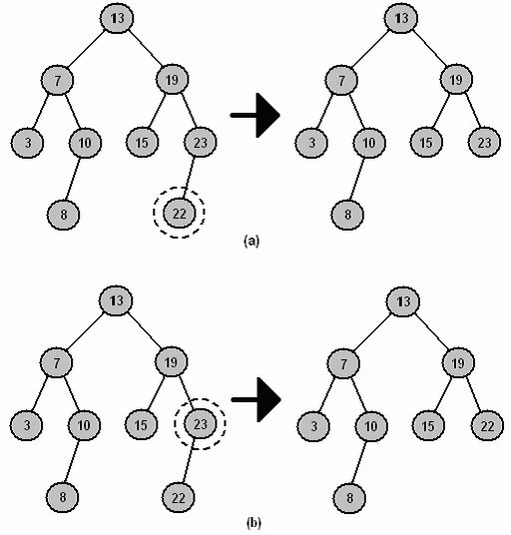

Slide 20
Deletion by Merging
One way of deleting nodes that have two children is called
deletion by merging.
This algorithm works by merging the two subtrees of the node and attaching the merged tree to the node’s parent.
In binary search trees, every value in the left subtree is less than every value in the right subtree,
so if we can find the largest value in the left subtree, then we can attach the right subtree as the right child of this node, and still preserve the ordered nature of the tree.
This process is illustrated in the following figure.
To find the largest value in the left subtree we need only keep tracking the right child pointer until a null is encountered. Symmetrically, this algorithm can also work by finding the smallest value in the right subtree, and attaching the left subtree to it.

Slide 21
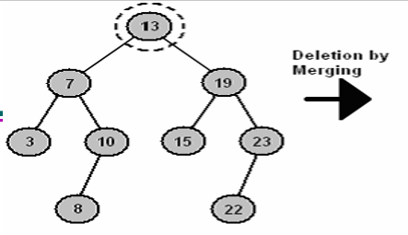
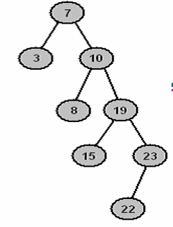

Slide 22
Deletion by Copying
Deletion by copying works in a similar fashion to deletion by merging.
» First, we find the largest value in the left subtree.
» Next, we copy this node, so that it replaces the node being deleted.
This process is illustrated in the above figure.
» The 10 node is a valid new root to the tree because it is greater than all nodes in the left subtree, and less than all nodes in the right subtree.
A slight complication with this algorithm can occur if the largest value in the left subtree has a left child.
In this case, the left child is attached to the nodes parent instead.
» For example, in above Figure the 10 node had a left child (node 8), so it was attached as the right child of 10’s parent, namely 7.

Slide 23
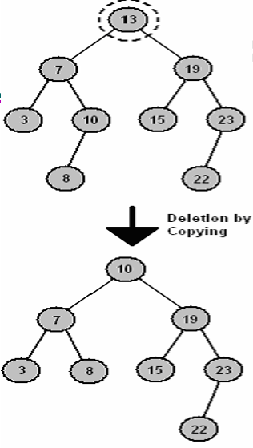
Deletion by Copying

Slide 24
Tree Traversal
Compared to linear data structures like linked lists and one dimensional arrays, which have only one logical means of traversal, tree structures can be traversed in many different ways.
Starting at the root of a binary tree, there are three main steps that can be performed and the order in which they are performed define the traversal type.
These steps are:
» Performing an action on the current node (referred to as "visiting" the node); or
» repeating the process with the subtrees rooted at our left and right
children.
Thus the process is most easily described through recursion.
28

Slide 25
Traversal Methods
To traverse a non-empty binary tree in preorder, we perform the following
three operations:
» 1. Visit the root.
» 2. Traverse the left subtree in preorder.
» 3. Traverse the right subtree in preorder.
To traverse a non-empty binary tree in inorder, perform the following
operations:
» 1. Traverse the left subtree in inorder.
» 2. Visit the root.
» 3. Traverse the right subtree in inorder.
To traverse a non-empty binary tree in postorder, perform the following operations:
» 1. Traverse the left subtree in postorder.
» 2. Traverse the right subtree in postorder.
» 3. Visit the root. This is also called Depth-first traversal
Finally, trees can also be traversed in level-order, where we visit every node on a level before going to a lower level. This is also called Breadth-first
traversal
29

Slide 26
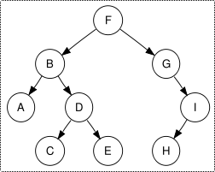
Cont…
Preorder traversal yields:
F, B, A, D, C, E, G, I, H
In-order traversal yields:
A, B, C, D, E, F, G, H, I
» Note that the in-order traversal of a binary search tree yields an ordered list
Postorder traversal yields:
A, C, E, D, B, H, I, G, F
Level-order traversal yields:
F, B, G, A, D, I, C, E, H

Slide 27
Implementation of Preorder
void preorder(Node *currNodeptr)
{
if(currNodeptr!=NULL){ cout<<currNodeptr->char;
preorder(currNodeptr->left); preorder(currNodeptr->right);
}
}
Preorder traversal yields:
F, B, A, D, C, E, G, I, H

Slide 28
Implementation of Inorder
void inorder(Node *currNodeptr)
{
if(currNodeptr!=null){ inorder(currNodeptr->left);
cout<<currNodeptr->char; inorder(currNodeptr->right);
}
}
In-order traversal yields:
A, B, C, D, E, F, G, H, I

Slide 29
Implementation of Postorder Traversal
Void postorder(Node *currNodepptr)
{
if (currNodeptr!=NULL){
postorder(currNodeptr->left); postorder(currNodeptr->right); cout<<currNodeptr->num;
}
}
Postorder traversal yields:
A, C, E, D, B, H, I, G, F

Slide 30
Balancing a Tree
If a tree becomes unbalanced, the efficiency of search operations using that tree can be affected.
A tree is perfectly balanced if it is balanced and all leaves are to be found on one or two levels.

Slide 31
How can we balance an unbalanced tree?
Often trees become unbalanced because of the order in which data arrives.
One technique to ensure trees become balanced is to change the order in which values are added to the tree.
achieved by storing all values in a linear data structure such as an array as they arrive.
When all values have arrived they can be added to the tree in such an order that leads to a well-balanced tree.

Slide 32
Example
3 7 8 10 12 13 15 19 22 23
The first node to be added to the tree is the middle element of the array, in our case 12. This effectively divided the array into two.
Next, we recursively build two sub trees based on the two remaining halves of the array.
Dealing only with the left half, the next node to be selected is 7. Again, this divides our array into two halves:

Slide 33
Cont…
3 7 8 10
The left half now consists of a single element, so this is added to the tree and we process the right half.
This consists of the values 8 and 10, so these are also added to the tree.
This process continues until all nodes have been added. In our case, the values will be added to the tree in the following order.

Slide 34
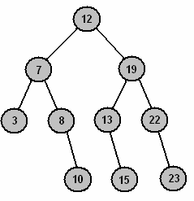
The Balanced Tree…

Slide 35
Cont…
The disadvantage of this algorithm is that it requires the arrival
of all values before we can start to use the tree.
This is not always possible.
It is always possible to use inorder traversal to transfer the data from the tree to an array, and then recreate the tree using the algorithm above.

Slide 36
Cont…
Self reading assignment
Heaps
Self adjusting binary tree

